Slide 1
ESFP-PROJECT SCHOOL DROPOUT RATIO {PID-048}
MRIGAKSH DASANI
CSE-12
BATCH-15

Slide 2
BRIEF INTRODUCTION about Page
This programming page helps you to get to know about School Dropout Ratio{ its causes , its effects and solutions}.
This programming page uses C language as its coding language.

Slide 3
SCHOOL DROPOUT RATIO
A recent survey by National Statistical Office (NSO) has revealed that around 12.6% of students drop out of school in India, 19.8% discontinued education at the secondary level, while 17.5% dropped out at the upper primary level.
The Government's Right to Education Act and National Policy on Education may have been motivating to provide education to all but it is equally important to analyze the sustainability and efficiency of the education system

Slide 4
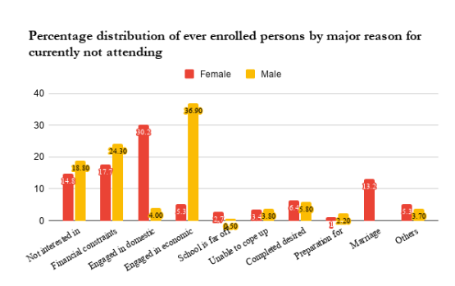
STATISTICS OF SCHOOL DROPOUT RATIO

Slide 5
SOLUTIONS FOR SCHOOL DROPOUT RATIO
The first is to provide efficient and sufficient infrastructure to all students and the second is to set up alternative and innovative education centers for the children of migrant laborers. These are vital steps to ensure that children have access to safe and engaging school education as well as bring back the ones out of school.
Schools should practice innovative teaching methods to draw students towards education and spark interest in them

